Slide 1
Noe-proteins, Spectrum assignment
Gordon Chalmers
Complex Carbohydrate Research Center
Department of Computer Science
note : 24 figures

Slide 2
Goal
This is high-performance.
New software has been developed
Calculate noes of large and small molecules
Proteins – e.g. St6Gal1, Skp1 with glycosylation, …
Predictions of intensities at arbitrary mixing times
Can be used for different reasons – including assignments of spectra
Used in genetic algorithm peak assignment

Slide 3
Output of programs
Correlation functions – general use in NMR calculations
Noe’s, relaxation rates, uses trajectories
Spectrum assignment – proteins, carbohydrates, molecules with different times scales of motion

Slide 4
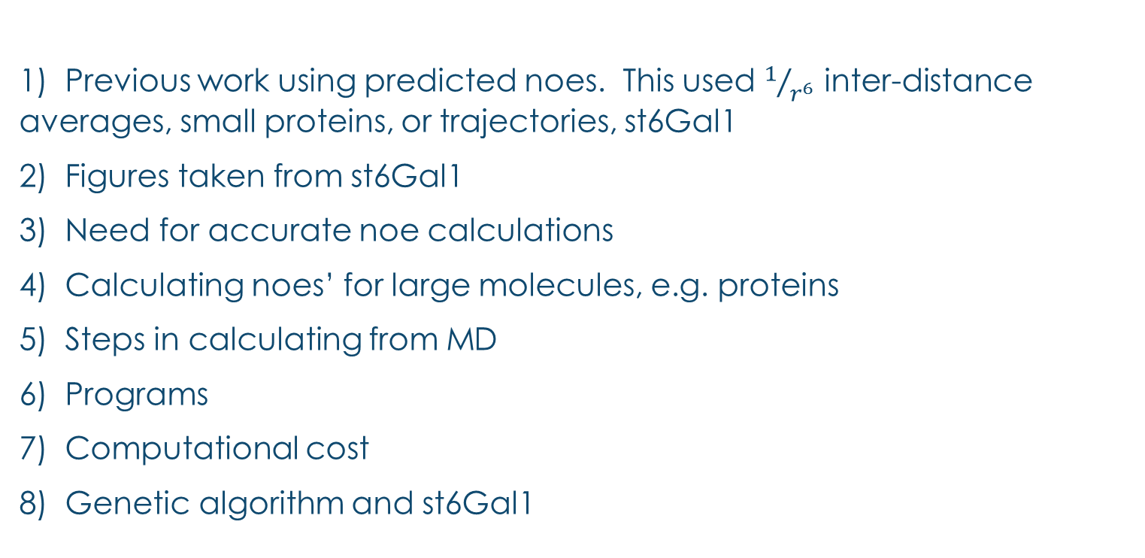
outline
1) Previous work using predicted noes. This used $1/{r^{6}}$ inter-distance averages, small proteins, or trajectories, st6Gal1
2) Figures taken from st6Gal1
3) Need for accurate noe calculations
4) Calculating noes’ for large molecules, e.g. proteins
5) Steps in calculating from MD
6) Programs
7) Computational cost
8) Genetic algorithm and st6Gal1
3 programs for real-time and user friendliness

Slide 5
Programs
Calculate correlation functions from trajectory (no b-field, frequency, or spin system information)
Calculate spectral density function (no spin system information)
Calculate noe’s, … (spin system initialization/finalization)
Time consuming
Not time consuming, real-time
Can be used to improve modeling and also to increase signal to noise in experiment

Slide 6
St6Gal1
Will use st6gal1 to illustrate the use
Complicated protein of 36 kDaltons
Difficult to assign
Have access to noe’s, rdc’s, chemical shifts, trajectories

Slide 7
Previous work
Genetic algorithm peak assignment available at Prestegard site and link from glycam.org
Successfully used in different small and large proteins
5 small proteins, including Robo1 – paper in JMB
HtpG labeled – paper in review
Skp1-glycan system in progress

Slide 8
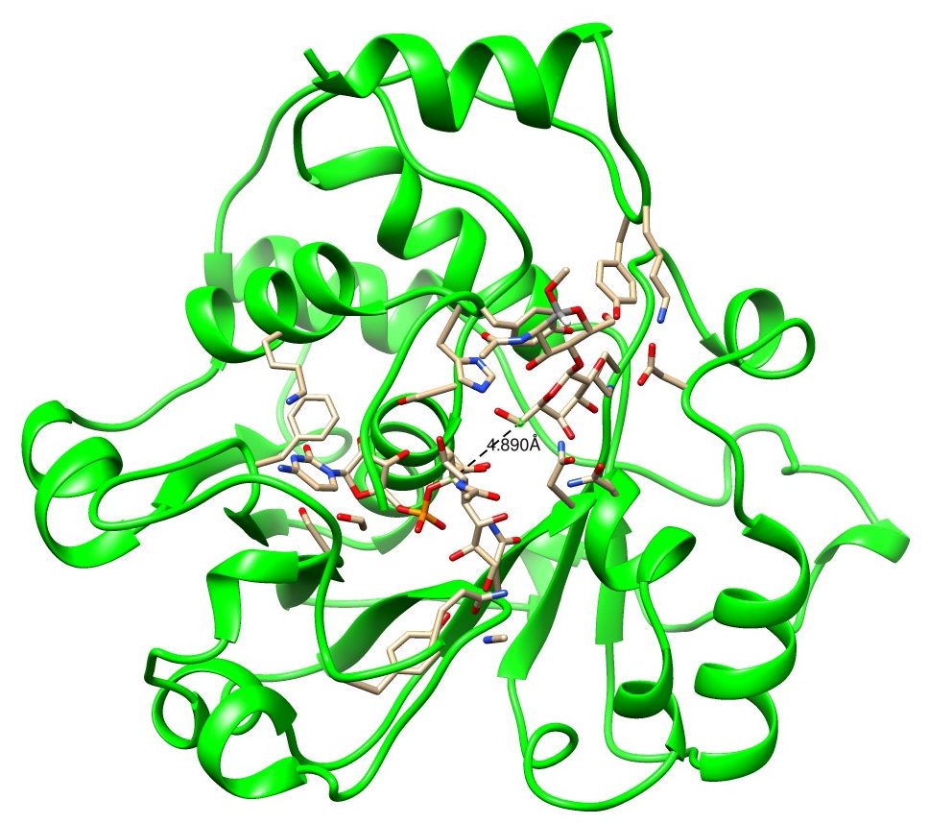
Why Sparse Labels? ST6Gal1 - a Key Mammalian Enzyme
36 kDa mammalian protein
Adds sialic acid 2-6 to Gal of N-glycans
Recent crystal structures 4JS1, 4MPS – donor in one
Questions:
Acceptor binds where?
Why is it so selective?
Challenge: Two N-glycosylation sites – one required – dictates mammalian cell expression
Notes:
Structure depicted is human 4js1 14 phes – rat MPS has 16

Slide 9
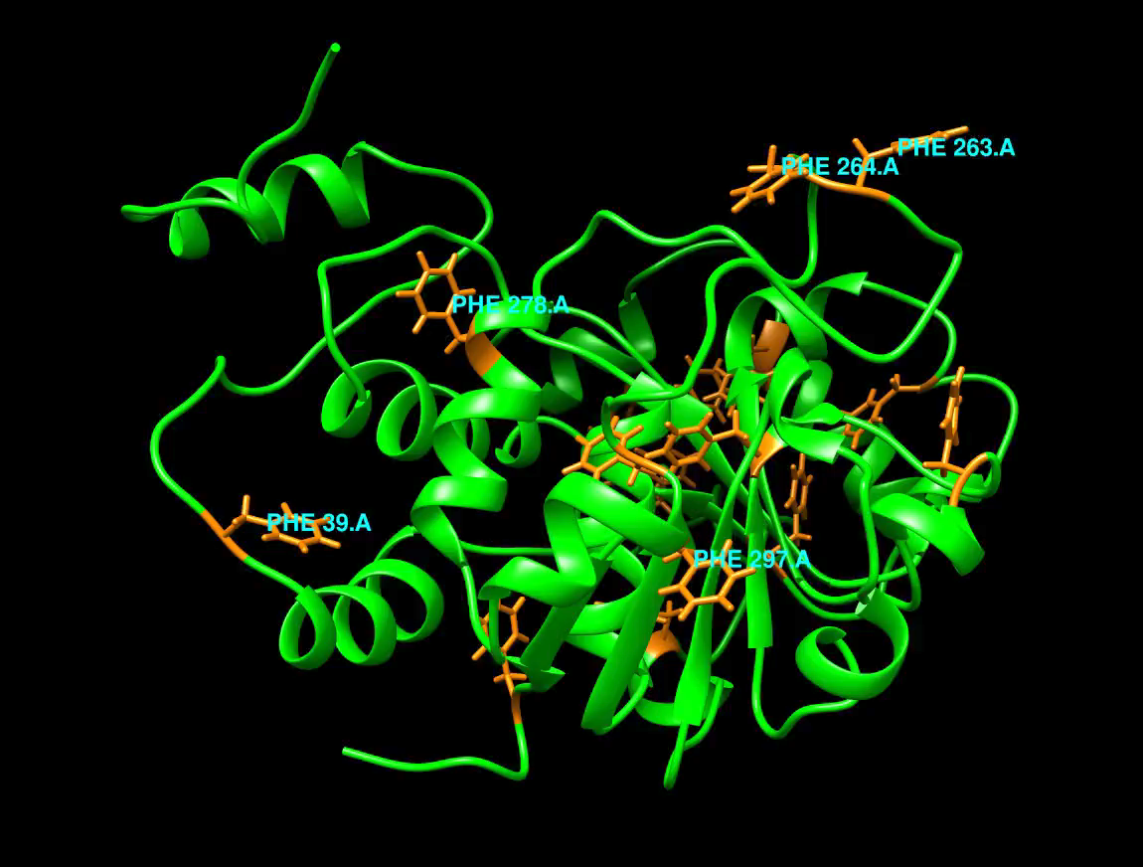

Slide 10
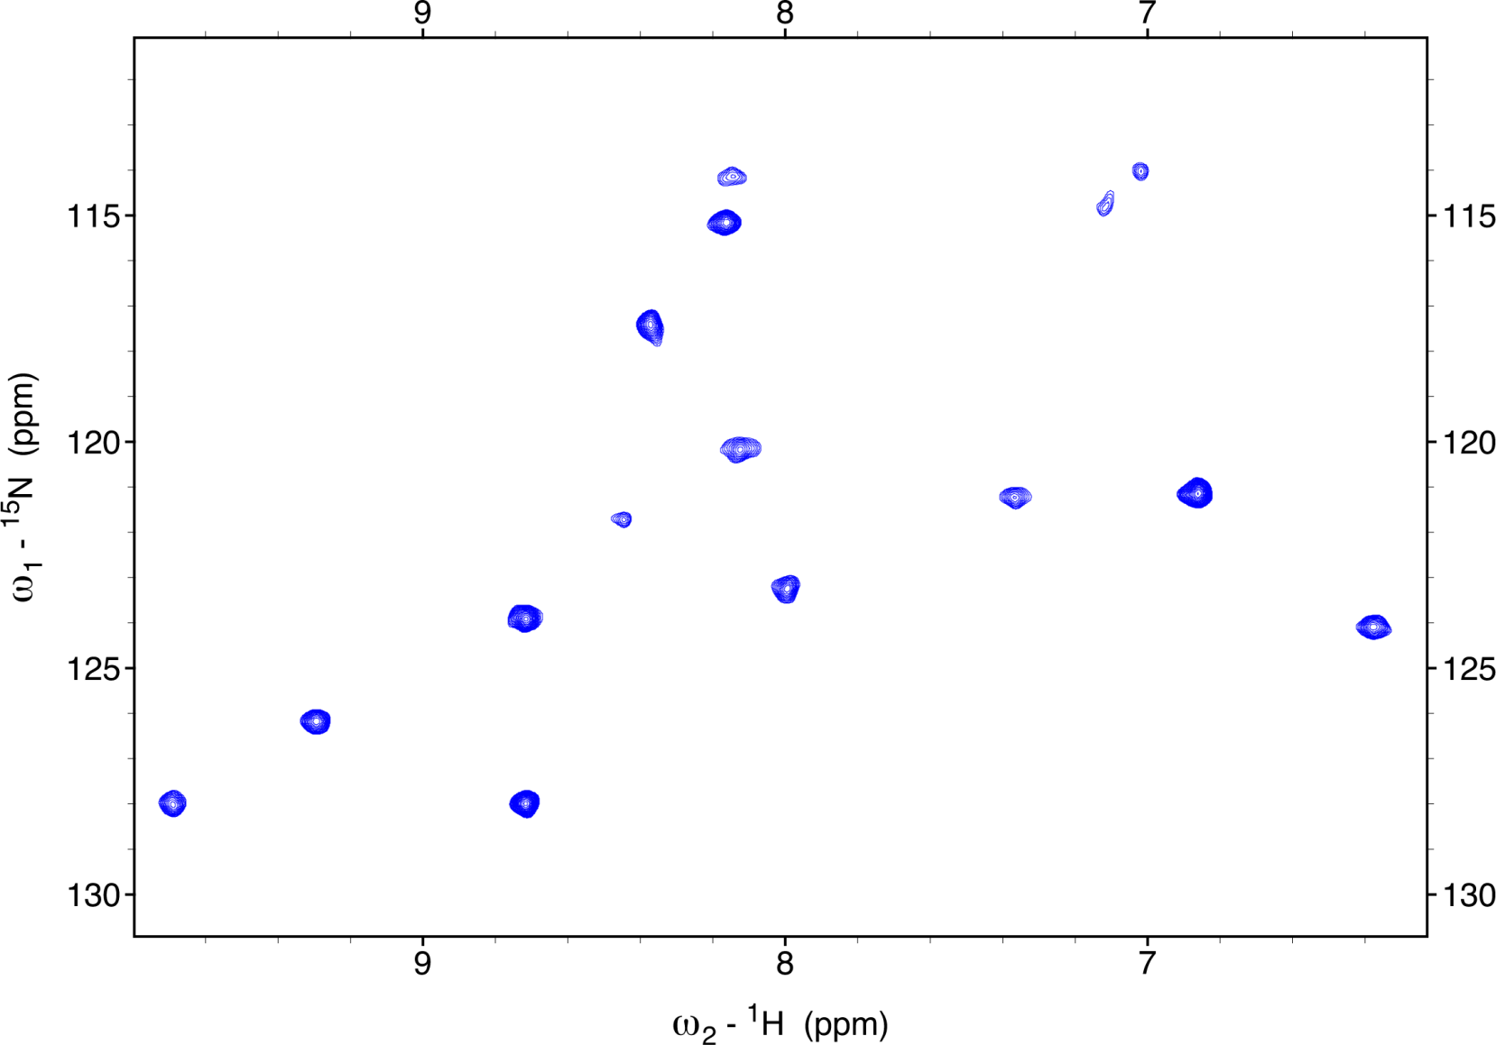
How do we Collect Data on This Protein?
Labeling with ¹⁵N-Labeled Amino Acids (Phenylalanine)
ST6Gal-1, Trimmed Glcyan, in 20 mM pH 6.5 Bis-TRIS Buffer, 200 mM NaCl

Slide 11
programs – difficulty of comparing with experiment
Programs can calculate protein noe’s from trajectories
Relaxation rates also, anything to do with spectral density function
Molecular simulations - difficulty with sampling
Changes of molecular structure are fast
Diffusion effects – indirect transfer of magnetization – can be important
Mobility of protons can really affect predictions if inter-distances are used.

Slide 12
Noe programs – difficult to calculate and would like no approximations, such as inter-distances and curve fitting
Programs are memory intensive
Time consuming to calculate noe’s
MD trajectories take time to create, 5 days, for 5000 atoms and 1 microsecond
Many people don’t have the computing resources
Experimentalists would like real-time calculations for experimental tuning of parameters
Lots of neighboring protons – unlike carbohydrates
1/r^6 approximation not good

Slide 13
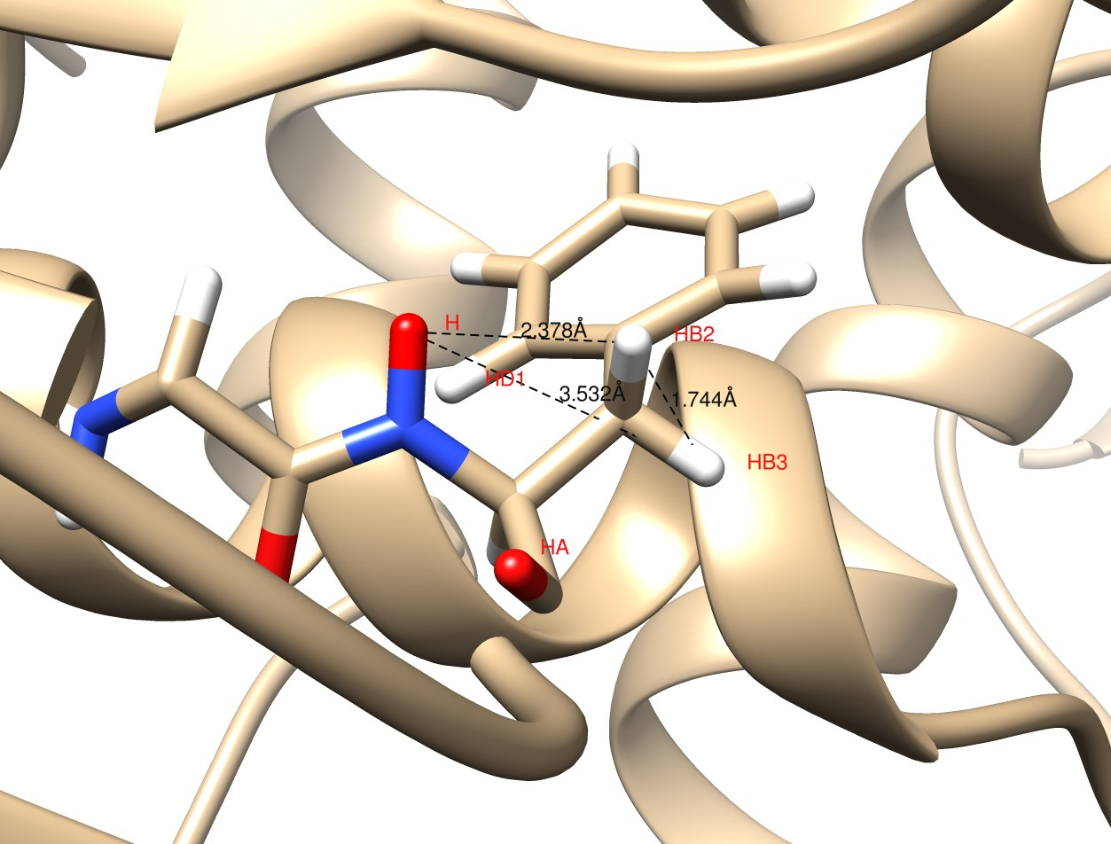
Example of Problem: F115 in ST6Gal1
Expected NOE results from 1/r⁶: I_{HD1}/I_{HB3} = 4.7
Notes:
HN-HD1 2.73 A

Slide 14
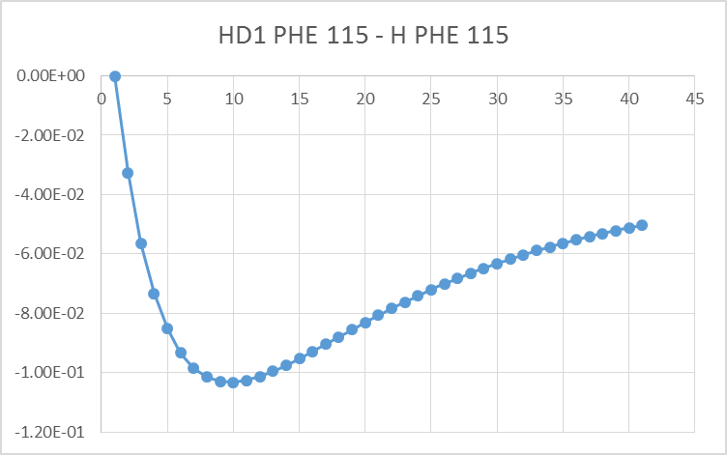
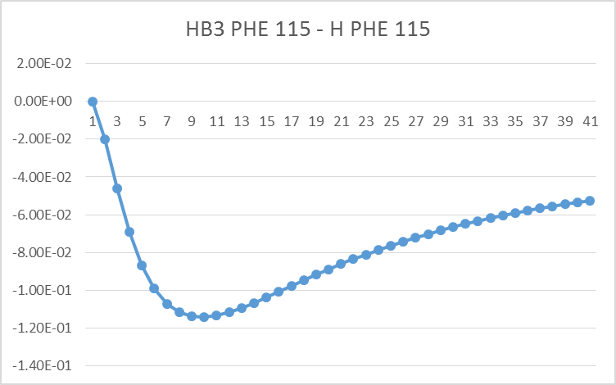
Results from Simulation
Indirect noe
50 ms
At 40 ms I_{HD1}/I_{HB3} = 0.9; not 4.7
Even at 10 ms I_{HD1}/I_{HB3} is only 1.2

Slide 15
Restructuring programs - reminder
Programs
Correlation function calculation
Complete relaxation rate matrix calculation
Noe or relaxation rate calculation
Efficient and user friendly
Real-time calculations
Can change spin system initialization/finalization, B-field, …, in real-time, which is good for computational and experimental work
These are separate programs.

Slide 16
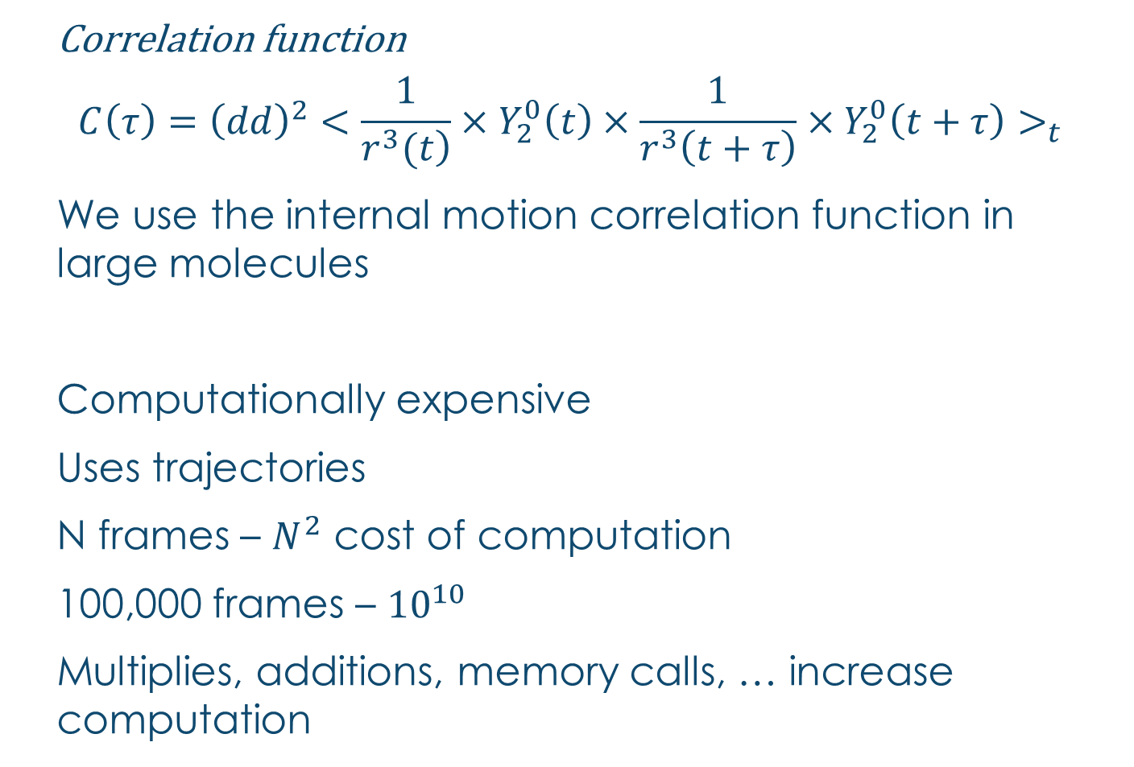
Correlation functions
Correlation function
$$C\left(τ\right)={\left(dd\right)}^{2}<\frac{1}{\left.r^{3}(t\right)}×Y_{2}^{0}\left(t\right)×\frac{1}{r^{3}\left(t+τ\right)}×Y_{2}^{0}\left(t+τ\right)>_{t}$$
We use the internal motion correlation function in large molecules
Computationally expensive
Uses trajectories
N frames – $N^{2}$ cost of computation
100,000 frames – ${10}^{10}$
Multiplies, additions, memory calls, … increase computation

Slide 17
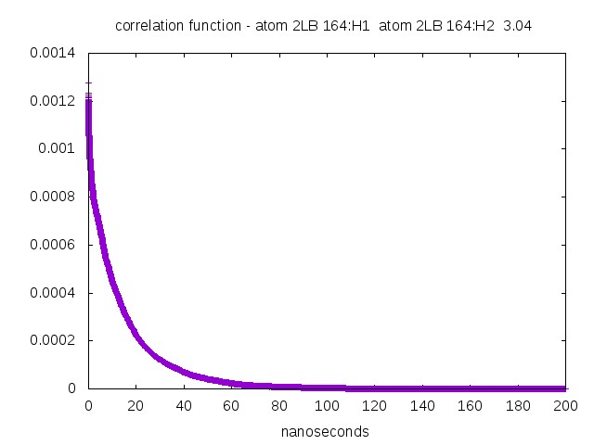
Example correlation function

Slide 18
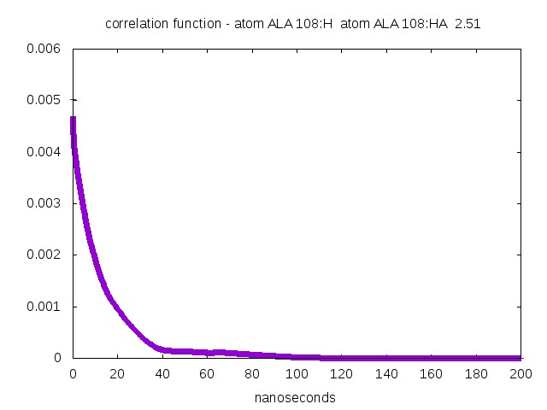
what looks like bumps – multiple processes not pathological. No approximations or curve fitting is done. Bad sampling – bad bumps.

Slide 19
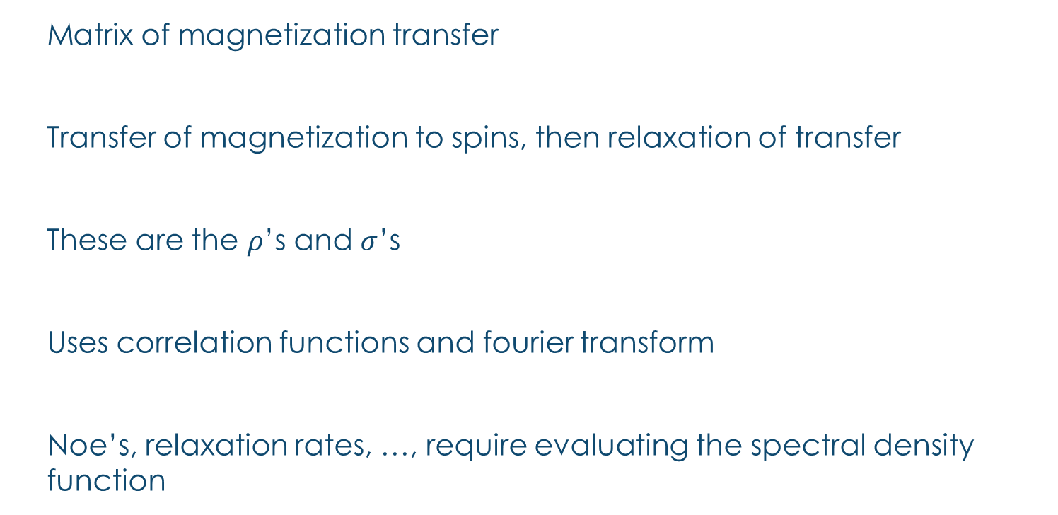
Complete relaxation rate matrix
Matrix of magnetization transfer
Transfer of magnetization to spins, then relaxation of transfer
These are the $ρ$’s and $σ$’s
Uses correlation functions and fourier transform
Noe’s, relaxation rates, …, require evaluating the spectral density function

Slide 20
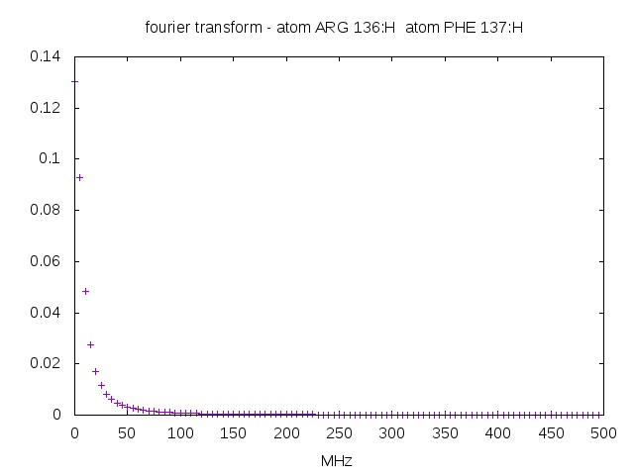

Example Fourier transform – zero frequency component in calculations are important
Intensity depends upon $1/{r^{6}}$ distance average

Slide 21
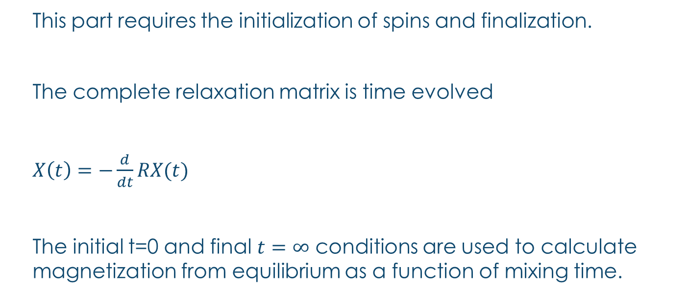
Noe curve calculation
This part requires the initialization of spins and finalization.
The complete relaxation matrix is time evolved
$X\left(t\right)=−\frac{d}{dt}RX(t)$
The initial t=0 and final $t=∞$ conditions are used to calculate magnetization from equilibrium as a function of mixing time.

Slide 22
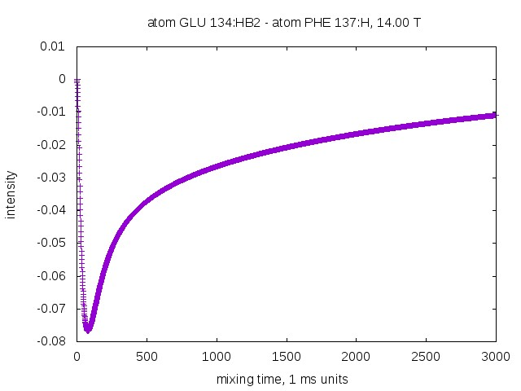

Example Noe curve
$ωτ>1.12$ : negative
Bad signal
Good linear model
This is the case for proteins.
Can be used to maximize signal to noise. Especially if many spin pair measurements are to be maximized.
Good signal
Needs complete calculation

Slide 23

approximations
Trajectories are not long enough
Accurate calculations require good sampling of tumbling and internal motion – overall tumbling a problem
Correlation function roughly goes as
Small molecules ok
Large molecules require an approximation
MD good at internal motion
Calculate internal motion part and add in to aligned trajectory the artificial tumbling
$$e^{−τ_{o}}e^{−τ_{i}}$$

Slide 24
How do we do this – ‘Sphere approximation’. Quasi-local, nonlinear.
Include all spin pairs with inter-distance < e.g. 5 A in complete relaxation rate matrix.
All spin pairs are within this this
sphere of radius R. Larger sphere, more spin pairs, more accuracy. More calculation.

Slide 25
approximation
This is not an approximation if the radius of the sphere is large enough, e.g. 7 angstrom with 5 A spin pairs
The distribution of protons is important for magnetization transfer.
Next slide.

Slide 26
Noe calculations and spin system – initialization/finalization
Cannot calculate this noe
Can calculate

Slide 27
Computational cost
Goes like N*N.
Optimized code to lessen the N*N coefficient.
Also the N coefficient.
53 atoms in spin pairs within the sphere – 90 minutes without parallelism.
Will improve and also with parallelism.
Change frame sample rate – in 2 frames - 45 minutes without parallelism
Don’t use all of C(t) in fourier transform
10 processors, 300 residues, r=7 Angstrom
: total < 15 hours
Potentially true if on-chip memory is used – will fit
Without on-chip allocation, 7 hours for 1000 ns and 16 residues

Slide 28
Programs summary - skip
3 linked programs.
More user friendly – less inputs for each and separate.
Of use in real-time calculations – e.g. useful for experimentalists to find best parameters and type of experiment.
1) correlation functions – calculate once
2) spectral density function – calculate at B-field over and over
3) calculate noe curves – depends upon experiment, calculate over and over

Slide 29
Application of noe program
Assigning spectra

Slide 30
Assigning using genetic algorithm
The output of the noe-protein programs predict noes’ from MD trajectories of large molecules and small molecules now.
The genetic algorithm has been used to sparsely label small and large proteins, including HtpG and st6Gal1.
Can also be used to assign spectra of proteins.
Carbohydrate spectra assignment, especially mid-size such that two or more time scales are in the motion
st6Gal1

Slide 31
ingredients
Noe’s at mixing time
Rdc’s
Predicted noe vectors (1-d spectra)
Chemical shifts
Or what is available, and also >1 media (e.g. phage, peg for alignment)
All of these use measurements and predictions from entire trajectory

Slide 32
Genetic Algorithm Assisted Sparse-Label Assignments
Gao, Chalmers, Moremen, Prestegard, J Biomol NMR , DOI 10.1007/s10858-017-0101-1

Slide 33
Residual dipolar couplings
Uses entire trajectory
Order parameters to correct for motion and population
Improvement over single pdb file or frame

Slide 34
ST6Gal1 Phage RDCs Fang Tian, July 2006

Slide 35
Results of RDC Averaging over trajectory
res x y z order
F39 -0.870446701 -0.46240163 -0.220470571 0.692786501
F62 -0.51892078 0.46827764 -0.72906603 0.918316012
F64 -0.945088614 -0.074234653 -0.348420333 0.928176515
F78 -0.040403268 -0.143700315 -0.998908302 0.9252258
F115 -0.792225461 0.009459518 0.626409879 0.9363588
F123 0.879684397 0.341432492 -0.360110003 0.854932536
F147 -0.46055643 -0.373219028 -0.817737936 0.940910153
F181 -0.51041096 -0.025867854 -0.871155271 0.927364537
F182 -0.201095236 -0.16700155 -0.975587612 0.943223317
F197 0.748291846 0.626846742 -0.259272976 0.931088716
F247 0.010761087 0.775709531 0.646729405 0.871783722
F263 0.980613162 -0.241648432 0.010191232 0.69615127
F264 -0.788877852 -0.61898747 -0.120939024 0.850914123
F278 0.512009011 -0.588235633 -0.641814313 0.938299898
F297 -0.390533146 0.907384153 -0.210327981 0.935450916
F305 0.532063017 -0.846396057 -0.143605924 0.944359676

Slide 36
Chemical shifts (N,NH)
Calculated as average over all frames or segment of trajectory using prediction programs (shiftX2, ppm1)
Different ‘models’ of prediction than carbohydrates
Found experimentally from identifying peaks in spectrum

Slide 37
Comparison of Experimental NOE Vector to Predictions
Experimental vector for crosspeak 7 (60 ms mixing time) - black
Predicted NOEs for first 8 residues positioned by PPM1 – green
F181 is clearly best fit, but maybe F62
-1 0 1 2 3 4 5 6 7 8 9 10 11
ppm ¹H

Slide 38
Matlab figures of spectra and calculation
Generate peak list from spectrum
Add gaussians to each peak
Same for calculated, using intensities and chemical shift errors
Spectra line-width very narrow, .001-.01 ppm

Slide 39
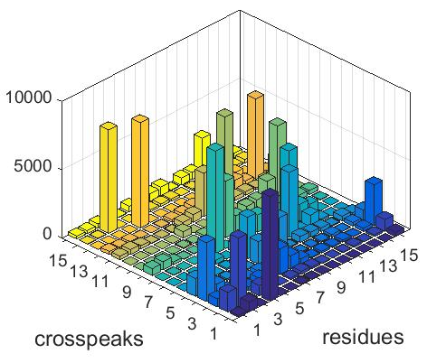
Frequencies of Assignment: 12 of 16 > 50%
Three of four closest residues are assigned
The fourth, F263, not included in calculation
Segment is absent in crystal structure
F115
F264
High confidence in these peak assignments
F247
Improved due to mobile region modeling in the trajectory.

Slide 40
statistics
Working on statistical quantities to evaluate spectrum assignment
Non-trivial due to peaks not 100% independent in assignment
Improves reliability and confidence of assignment

Slide 41
States of proteins
Proteins also have ‘conformations’
Noe’s and genetic algorithm can be used to identify and to calculate populations
Still not good enough sampling …
Rdc’s and chemical shifts also are used

Slide 42
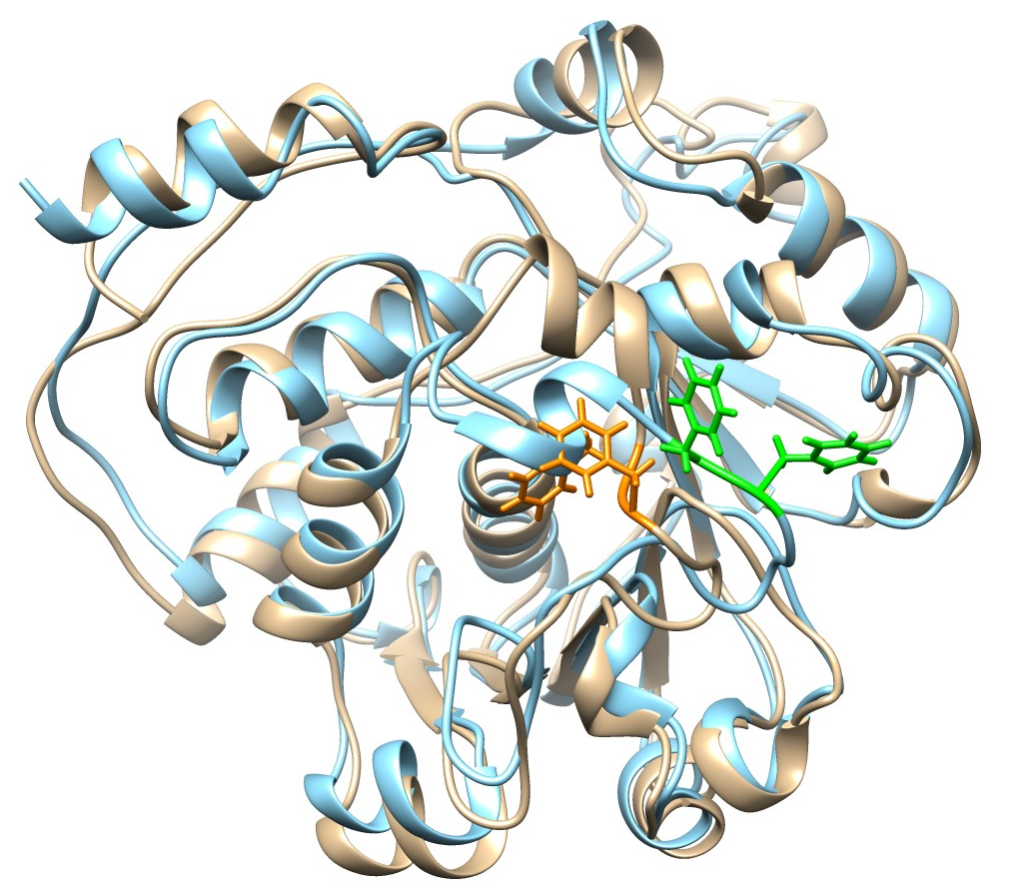
rST6Gal1 1μs MD Final Structure
Note that Phe 264 in the final structure (orange) is buried
Good hydrophobic contacts – Asp 255 also has new H-bonds
Transition between 2 distinct states, about residues 263/264
Genetic algorithm used to identify population

Slide 43
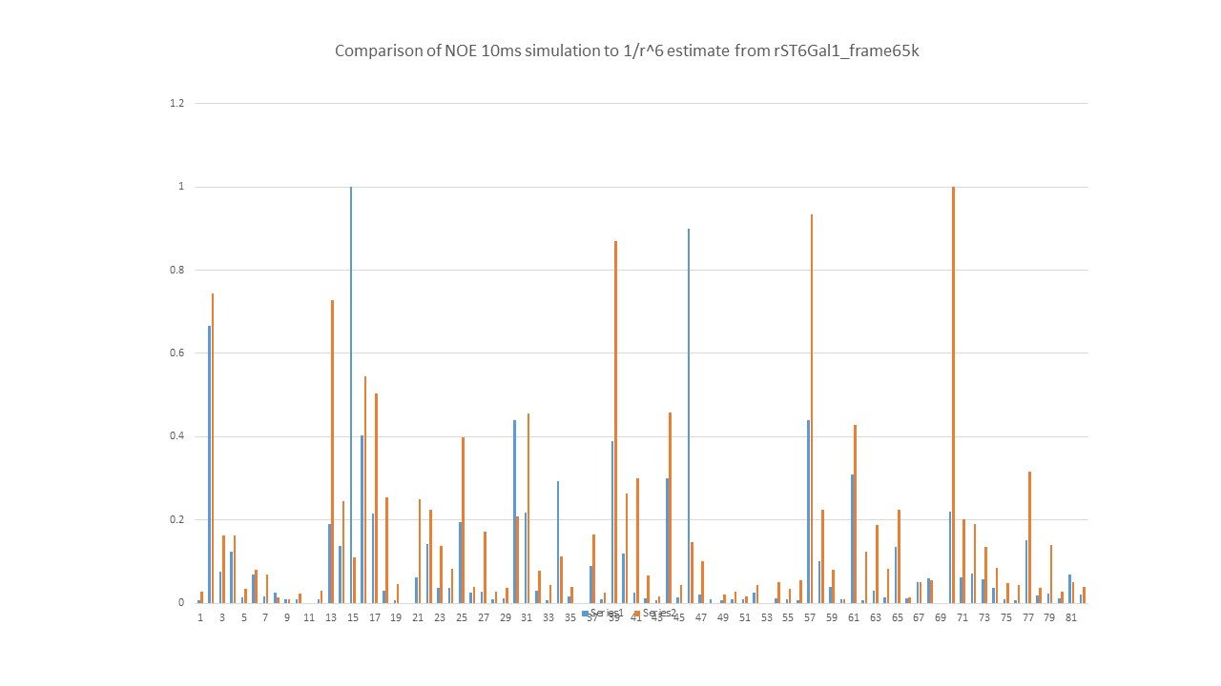
1/r⁶ Prediction Versus 10ms Simulation ¹⁵N-filtered NOEs for lysine labeled ST6Gal1
Both under and over estimates occur
For assignments – no reason to collect initial slope
Information content may be higher near NOE min

Slide 44
carbohydrates
Use unaligned trajectory, good sampling
Calculate correlation functions
From nmr spectra ‘guess’ at structure, or use a structure
Run through the noe and genetic algorithm programs
Obtain assignment of peaks

Slide 45
conclusions
Calculate noes’ for large molecules, such as proteins
Better than previous techniques, such as those based upon distances
Gives parameters, e.g. mixing times, initialization/final spins, for ideal work
Used in genetic algorithm assignment programs
Can also be realistically used in the assignment of spectra
Software is efficient and can run in real-time without parallelism
User friendly
Can be used by computational chemists and also experimentalists to improve work

